Slide 1
Sacred Trusts
Part 1
What God Has Entrusted To Us
Notes:
By sacred trust, I mean to convey something that God Himself has entrusted or given to us to manage. We understand this when we deposit out money into a bank or when we entrust our health or perhaps life into a surgeon. When something is entrusted to us, it requires our faithful care and responsibility toward it (1 Cor. 4:1, 2).

Slide 2
gospel
“But as we have been approved by God to be entrusted with the gospel, even so we speak, not as pleasing men, but God who tests our hearts” (1 Thess. 2:4)
Sacred Message
1

Slide 3
Question
“What character ought we to have who are entrusted with the gospel of God?”
  Paul’s example outlines the type of character that is worthy of the gospel

Slide 4
1 Thessalonians 2:1-12
Tenacious (2:1, 2)
Notes:
In Paul’s day the world was inundated with many false beliefs, false gods, false teachers, etc. But true ministers of the gospel stood out and apart from frauds the same way our true God stands out and apart from man-made gods. It is the character of the Christian and here we see the Christian proclaimer that stands out and above others.
TENACIOUS – Paul was relentless and did not lose heart amidst conflict. The Christian needs to respect the fact that the gospel is an offense to many. Being an offense, it will turn many away. It will make others angry. We should not minimize this aspect of the gospel. Because the gospel ruptures the hearing and thinking of so many, it manifest a tenacious spirit with those who are entrusted with it. Paul’s relentless forward movement with the gospel amidst conflict was based on his absolute confidence in it (2 Cor. 3:12). It should also be well remarked as someone once said, “The mark of a great leader is not how well he avoids conflict, but how courageously he accepts it.”

Slide 5
1 Thessalonians 2:1-12
Tenacious (2:1, 2)
Sincere (2:3)
Accountable (2:4-6)
Affectionate (2:7, 8)
Leading by example and guiding (2:9-12)
Notes:
SINCERE - Paul’s conduct was authentic, genuine and honest. His exhortation did not stem out of a source of error, uncleanness (impurity) or deceit (word means decoy, like bait). As his message was genuine, so Paul’s heart was sincere when preaching it (2 Cor. 1:12; 2:17). Sincerity is often measured by diligence (2 Cor. 8:8; Col. 3:22).
ACCOUNTABLE – We are often accountable to men, but Christians, preachers and elders fail the course they are on when they lose sight of their answerability to God (Heb. 13:17; Rev. 2:23).
AFFECTIONATE – No picture can rival the affectionate loving care of a mother with her nursing infant. Patience and care is a mark of motherhood and so it is for God’s ministers (see Phil. 2:19-22).
Finally Paul balances the character portrait that is worthy of the gospel as that of a father. The full spectrum is here given. The mother affectionately and tenderly cares for the needs as well as the father who leads and instructs in righteousness. Such a quality yields spiritual strength and direction.

Slide 6
Evangelists
Sacred Soldiers
2

Slide 7
2 Timothy 2:1-7
  BE STRONG IN THE GRACE
  VERSE 1, “You therefore, my son, be strong in the grace that is in Christ Jesus”
  Grace requires courage
  Preachers need such in preaching, expounding, applying, rebuking and exhorting (2 Tim. 2:15; 4:2-5)
    In enduring rejection (2 Tim. 1:7,8, 15)
  A feature all Christians are to possess regarding the faith (Eph. 6:10)

Slide 8
2 Timothy 2:1-7
  2. BE FAITHFUL
  VERSE 2, “And the things that you have heard from me among many witnesses, commit these to faithful men who will be able to teach others also.”
    The word of God’s grace needs to be received and committed (entrusted) to others who are faithful
    How much emphasis do we place on the faithfulness of the preacher?
    How much emphasis do we place on transmitting it to other faithful men?

Slide 9
2 Timothy 2:1-7
  Threefold Picture of Preachers
  1) SOLDIER (2:3, 4)
    Hardship to be endured
    Engaged in warfare
    Not to become entangled in the affairs of this life
    Must please the one who enlisted him (cf. Gal. 1:10)

Slide 10
2 Timothy 2:1-7
  Threefold Picture of Preachers
  1) SOLDIER (2:3, 4)
    The denominational world has effectively erased this characteristic of God’s minister
Notes:
A salesman
A stand up comic
A praying nurse who spends his time visiting the sick
An entertainment organizer for the church (a camp planner, a babysitter, a coach, and a big brother to the youth)
A psychologist (a counselor for broken families and those with low esteem)
A motivational speaker who sprinkles levity and jokes into life
I don’t see much of them seeking to be soldiers of Christ.

Slide 11

2 Timothy 2:1-7
  Threefold Picture of Preachers
  1) SOLDIER (2:3, 4)
    God’s preacher is a teaching soldier
      He wields the word as a sword (Is. 49:2; Eph. 6:17; Heb. 4;12; Rev. 1:16; 2:16; etc.)
      He casts down citadels of error (2 Cor. 10:2-6)
      Must spend time wielding the sword by giving himself over to continual study (2 Tim. 2:15)
        “Till I come, give attention to reading, to exhortation, to doctrine” (1 Tim. 4:13)
        “give attention” (take heed, turn your mind to, hold to, addicted to, devoted to)
Notes:
How would Jesus come against this church and fight against them with the sword of His mouth? Would it not in part be with true gospel preachers slaying the error in which they held with the word of God (2 Cor. 10:2; 12:20, 21; 13:10)?

Slide 12
God’s Soldier
Does the denominational world really look at their ministers as soldiers?
Notes:
As they have perverted the Bible pastor and the Bible evangelist and have made a mockery out of both works and words, so they have treated Christ by transforming this Holy One of God into an all accepting tolerant man. This is infiltrating into the church too. I read an article by a member of the church of Christ who wrote how Jesus can use drug dealers and prostitutes. He cannot use such in the kingdom for such cannot inherit the kingdom of heaven as a drug dealer or prostitute. They must repent.
I came across an interesting article by a member of a denomination somewhat taking to task the common concept of who a pastor is within his circle of influence…

Slide 13
Challenging The Denominational Pastor Concept
“However, a much more common view of the pastor in the church, often arrived at by default rather than analysis, is to regard the pastor as the chief worker of the church. Tasks of administration, visitation, counseling, assuaging difficulties, and many other, individually minor, demands on his time have the combined effect of squeezing out what scripture regards as the pastor's primary responsibility—that of teaching the people of God the truths of God’s word and principles of godly living. Many pastors are pressured by people in their congregations to be "more visible" or "more accessible." Those who demand these things have little understanding that time spent in private study or in the solitary prayer closet may be of much greater value to the Body of Christ than endeavoring to be seen doing what the people want the pastor to do” (Keith Schooley, What Is A Pastor?... http://www.quodlibet.net/articles/schooley-pastor.shtml)
Notes:
He continued. “But when a pastor spends the majority of his time ‘taking time out’ to do these things, he risks neglecting the gift he has been given… The success of the modern megachurch may be due partly to the fact that a senior pastor, often a gifted preacher and expositor, is freed by his staff to actually do the work he has been called to do. How much more effective might the Church be if all those who are called to teach the word of God were able to do the same thing?” (ibid.)

Slide 14
Lest We’re Influenced By The Denominations Around Us
“And He Himself gave some to be apostles, some prophets, some evangelists, and some pastors and teachers” (Eph. 4:11)
Some denominations are starting to see the pastoral position they have created as a failure!
Bible
Pastors
Bible Evangelists
Bible
Pastors
Denomin. Pastors
Notes:
Redefining who a pastor is makes a mortal man contend with the Father as to who a pastor is. When man changes the Bible definition of a pastor, he looks just as pathetic defining what a pastor is to God as does the man who seeks to define what marriage is to God.

Slide 15
“If anyone speaks, let him speak as the oracles of God…” (1 Pet. 4:11)
A very telling mark of the New Testament church is found in the organization
  Bible “pastors” are “elders and bishops”
  Work is within an “eldership” that is composed of two or more men (Acts 14:23; 20:17, 28; 1 Tim. 4:14; etc.)
NO LONGER
PURE
Man’s
Thinking
GOSPEL
INFUSED
Notes:
Redefining who a pastor is makes a mortal man contend with the Father as to who a pastor is. When man changes the Bible definition of a pastor, he looks just as pathetic defining what a pastor is to God as does the man who seeks to define what marriage is to God.

Slide 16
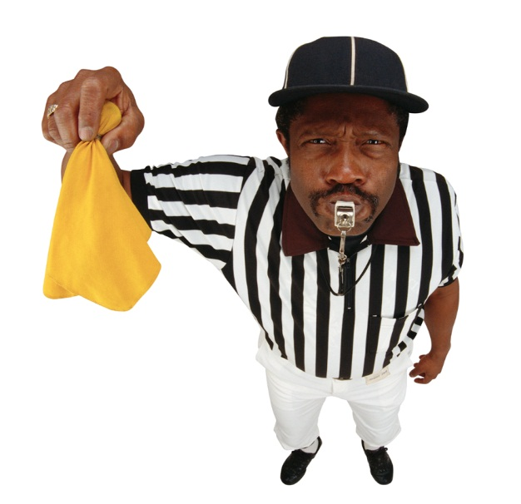
2 Timothy 2:1-7
  Threefold Picture of Preachers
  2) Athlete (2:5)
  The emphasis in this verse is not as much on the level of his endurance, as it is upon the way he struggles—according to the rules or laws
    Emphasizes the doctrinal importance of an enduring evangelist (2:15)
    His preaching must be according to the rules/doctrine (Titus 2:15; 1 Tim. 4:13)

Slide 17

2 Timothy 2:1-7
  Threefold Picture of Preachers
  3) Farmer (2:6)
  Hardworking
    “Take heed to yourself and to the doctrine. Continue in them, for in doing this you will save both yourself and those who hear you” (1 Tim. 4:16)
  Recompense
    The suffering and service precedes the reward
    “Who ever goes to war at his own expense? Who plants a vineyard and does not eat of its fruit? Or who tends a flock and does not drink of the milk of the flock?” (1 Cor. 9:7)

